Slide 1
Introduction to FHIR
Lloyd McKenzie
January 14, 2013

Slide 2
This presentation
Can be downloaded here:
TODO
Is licensed for use under the Creative Commons, specifically:
Creative Commons Attribution 3.0 Unported License

Slide 3
Who am I?
Name: Lloyd McKenzie
Company: Gordon Point Informatics (GPi)
Background:
Initial participant in FHIR core team
Co-chair FHIR Management Group
Co-chair HL7 Modeling & Methodology
Chair HL7 Canada Architecture & Infrastructure
Heavily involved in HL7 and healthcare exchange for last 14 years (v2, v3, CDA, etc.)

Slide 4
Who are you?
What’s your background with HL7?
v2? v3? CDA? Brand new?
What’s your role?
Developer? Manager? Clinician? Other?
What’s the single most important thing for you to get out of today’s course?

Slide 5
Tutorial Objectives
You should:
Be able to explain what FHIR is to others in your organization
Know where FHIR fits in the broader healthcare landscape, including other HL7 specifications
Be equipped to help your organization determine if, when, where and how you might use FHIR
Know how to approach the FHIR specification to find out what more you need to know

Slide 6
What is FHIR?

Slide 7
Answer: An instigator of bad puns
FHIR is the hottest thing since . . .
This spec is spreading like . . .
Committee X is really on FHIR
Feel free to come up with your own
(but please, not here ☺)

Slide 8
The Need
Has been a need to share healthcare information electronically for a long time
HL7 v2 is over 25 years old
Increasing pressure to broaden scope of sharing
Across organizations, disciplines, even borders
Mobile & cloud-based applications
Faster – days or weeks, not months or years
Notes:
Who

Slide 9
The Need
Q: So what did HL7 have to offer in this space?
A: Not much
V3 attempted to address some of these issues, but too slow and too hard
CDA has had the most success, but both limited and still too hard

Slide 10

Genesis of FHIR
HL7 undertook a “Fresh look”
What would healthcare exchange look like if we started from scratch using modern approaches?
Web search for success markers led to RESTful based APIs
Exemplar: Highrise (https://github.com/37signals/highrise-api)
Drafted a healthcare exchange API based on this approach

Slide 11
The acronym
F – Fast (to design & to implement)
Relative – No technology can make integration as fast as we’d like
H – Health
That’s why we’re here
I – Interoperable
Ditto
R – Resources
Building blocks – more on these to follow

Slide 12
FHIR Principles

Slide 13
FHIR Manifesto
Focus on Implementers
Target support for common scenarios
Leverage cross-industry web technologies
Require human readability as base level of interoperability
Make content freely available
Support multiple paradigms & architectures
Demonstrate best practice governance
Notes:
We don’t actually have a formal manifesto, but these are the principles we adhere to.

Slide 14
Implementer Focus
Specification is written for one target audience: implementers
Rationale, modeling approaches, etc. kept elsewhere
Multiple reference implementations from day 1
Publicly available test servers
Starter APIs published with spec
Delphi, C#, Java – more to come
Connectathons to verify specification approaches
Additional weight given in ballot feedback to those with implementation experience
Notes:
Who’s read the v3 spec? – modeler & balotter focused
Spec is driven by people who write code
Numerous pieces have been changed because of experience with what worked when trying to implement

Slide 15
Support “Common” Scenarios
Inclusion of content in core specification is based on “80%” rule:
“We only include data elements if we are confident that 80% of implementations maintaining that resource will make use of the element”
Other content pushed to extensions
(more on this later)
Easy to say, governance challenge to achieve
Notes:
Design by constraint failed – years to develop, what was produced required yet more design to be implementable and after that might not be interoperable
How to determine the 80%? Look to existing specs – v2, v3, CDA templates, OpenEHR, jurisdictional projects, what implementations we’ve seen
If not sure, err on the side of “not in for now”
Challenges with “raising the bar”
What happens when there aren’t many/any implementations?

Slide 16
Web technologies
Instances shared using XML & JSON
Collections represented using ATOM
Same technology that gives you your daily news summary
Out-of-the-box publish/subscribe
Web calls work the same way they do for Facebook & Twitter
Rely on HTTPS, OAuth, etc. for security functions
Notes:
We try very hard to *not*

Slide 17
Human Readable
CDA taught HL7 a very important lesson
Even if the computers don’t understand 99% of what you’re sending, that’s ok if they can properly render it to a human clinician
This doesn’t just hold for documents – important for messages, services, etc.
In FHIR, every resource is required to have a human-readable expression
Can be direct rendering or human entered
Notes:
Even when you think your target will understand all the encoded data, reality is data often gets shared beyond the originally intended context
Allow for exceptions for things like automated device readings, etc.

Slide 18
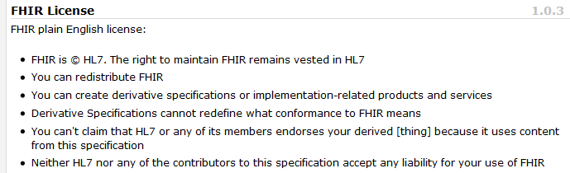
Freely available
Unencumbered – free for use, no membership required
http://hl7.org/fhir
Notes:
Was a bigger deal before HL7 decided to open up all IP
full legal text towards bottom of FHIR home page

Slide 19
Governance
Oversight
TSC
Methodology
MnM
Governance
FGB
Management
FMG
Content
Work Groups
Content
Core Team
Notes:
FHIR Governance Board
Maintains FHIR principles
Identifies risks, precepts
Handles coordination w/ external groups
FHIR Management Group
Coordinates Work Groups
Manages ballot process
Education delivery
Day-to-day activities
Modeling & Methodology
Defines criteria for artifacts
Determines processes
Documents best practices
Work Groups
Do the actual development work
Core Team
Temporary
Takes on work Work Groups can’t
Expedites
What haven’t we talked about yet?

Slide 20
Paradigms and Architectures

Slide 21
Paradigms
FHIR supports 4 interoperability paradigms
REST
Documents
Messages
Services

Slide 22
REST
Simple, out-of-the-box interoperability
Leverage HTTP: GET, POST, etc.
Pre-defined operations
Create, Read, Update, Delete
Also: History, Read Version, Search, Updates, Validate, Conformance & Batch
Works best in environments where control resides on client side and trust relationship exists
Notes:
URLs, parameters, etc. all defined
Choice of what operations to support
Behavior documented in conformance profile - mandatory

Slide 23
Documents
Similar to CDA
Collection of resources bound together
Root is a “Document” resource
Just like CDA header
Sent as an ATOM feed
One context
Can be signed, authenticated, etc.

Slide 24
Messages
Similar to v2 and v3 messaging
Also a collection of resources as an ATOM feed
Allows request/response behavior with content included in response
Event-driven
Todo

Slide 25
Using Resources
Classic HTTP RESTful approach
Simple approach led by Facebook, Twitter, etc.
Atom (RSS feed standard)
Use Atom to “bundle” resources
Pub/sub framework, Multi-resource Transactions
Messages (v2-like), Documents (per CDA)
Custom Services / SOA
Same content
Same base rules

Slide 26
FHIR Resources

Slide 27
Resources
“Resources” are:
Small logically discrete units of exchange
Defined behaviour and meaning
Known identity / location
Smallest unit of transaction
“of interest” to healthcare
V2: Sort of like Segments
V3: Sort of like CMETs

Slide 28
What’s a Resource?
Examples
Non-examples
Administrative
Person, Patient, Organization, Facility, Coverage, Invoice
Clinical Concepts
Allergy, Problem, Family History, Care Plan
Infrastructure
Document, Message, Profile, Conformance
Gender
Too small
Electronic Health Record
Too big
Blood Pressure
Too specific
Intervention
Too broad

Slide 29
Resources
Resources have 3 parts
Defined Structured Data
The logical, common contents of the resource
Mapped to formal definitions/RIM & other formats
Extensions
Local requirements, but everyone can use
Published and managed
Narrative
Human readable (fall back)

Slide 30
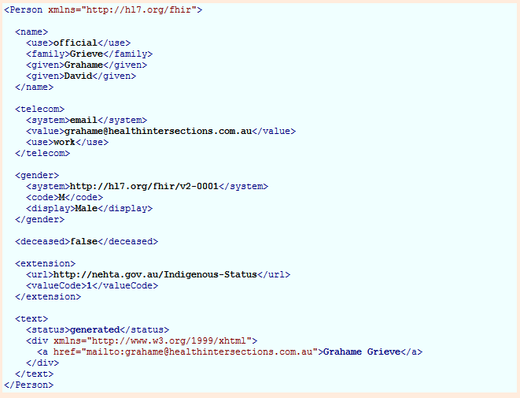
Person

Slide 31
Resources
Resources have 3 parts
Defined Structured Data
The logical, common contents of the resource
Mapped to formal definitions/RIM & other formats
Extensions
Local requirements, but everyone can use
Published and managed
Narrative
Human readable (fall back)

Slide 32
FHIR Extensions

Slide 33
The Case for Extensions
Extensions are often problematic in existing HL7 specs
Z-segments in v2
Foreign namespaces in CDA/V3
Simple choice – design for absolutely everything or allow extensions

Slide 34
Extensions without the pain…
Extensions are built into the wire format
All conformant systems can “handle” any possible extension - Just a bucket of “other stuff”
Use mustUnderstand to flag extensions that “change things”
Require formal definitions of extensions to be available in interoperability space
Extensions rendered in human readable portion

Slide 35
Reading the FHIR Spec

Slide 36
The Specification
Introduction
Background, basics, framework
Implementation
HTTP, conformance, JSON, etc.
Resource Definitions
Actual logical definitions of resources and their behaviour

Slide 37
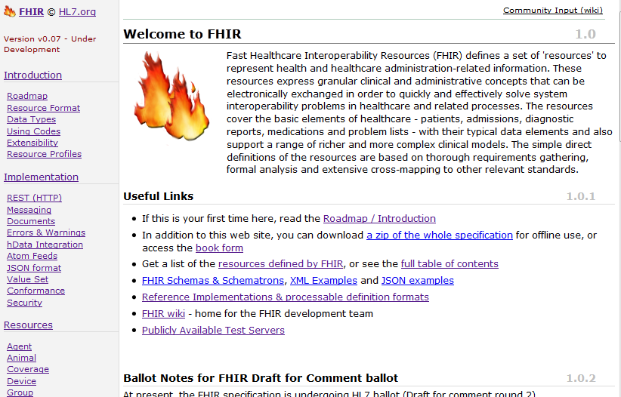
(FHIR home)

Slide 38
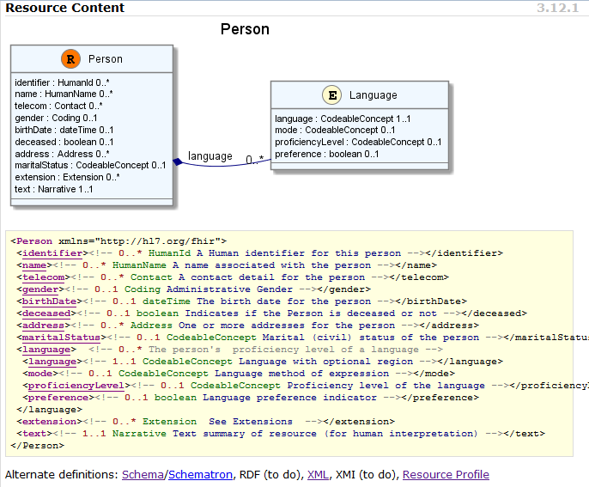
(FHIR person)

Slide 39
Messages & Documents

Slide 40
Profiles & Conformance

Slide 41
FHIR in Context

Slide 42
Why FHIR?
Existing standards are not a platform for the future:
V2 – venerable, but old technology, self limiting
V3 – thorough and correct, but not practical
CDA – well established, but also limited in scope and difficult
Different approaches not reconciled

Slide 43
Implementing FHIR

Slide 44
Where can FHIR be used?
Classic in-institution interoperability
Back-end e-business systems (e.g. financial)
Regional Health Information Organizations (RHIO)
National EHR systems
Social Web (Health)
Mobile Applications
Near
Term

Slide 45
Collaborations
IHE
investigating - use of FHIR for MHD (mobile XDS)
DICOM
interested - RESTful access to image metadata
W3C
Semantic health group helping us with RDF, RIM-based semantic checking

Slide 46
Future Plans
2nd Draft for comment open now
Infrastructure very solid (implementation focus)
Definitions & Mappings need work
Resource coverage needs to broaden
Next ballot cycle – DSTU grind starts
Publish FHIR as full DSTU
Testing, real world implementation experience

Slide 47
Next Steps
Read the spec: http://hl7.org/fhir
Comment on the wiki (link from FHIR spec)
Follow #FHIR on Twitter
Shape the specification:
Join the FHIR track at this WGM
Join the FHIR email list http://wiki.hl7.org/index.php?title=FHIR_email_list_subscription_instructions
Try implementing it
Make Ballot comments
Come to the Connectathon!

Slide 48
Review

Slide 49
What does FHIR provide?
Resources (building blocks)
Extensions
Methodology
Bundles, Profiles, Conformance
Syntax (XML, JSON)
Human readability
Support for multiple Paradigms
REST, Messaging, Documents, Services

Slide 50
FHIR Manifesto
Focus on Implementers
Target support for common scenarios
Leverage cross-industry web technologies
Require human readability as base level of interoperability
Make content freely available
Support multiple paradigms & architectures
Demonstrate best practice governance
Notes:
We don’t actually have a formal manifesto, but these are the principles we adhere to.

Slide 51
Questions?
http://hl7.org/fhir

